Slide 1
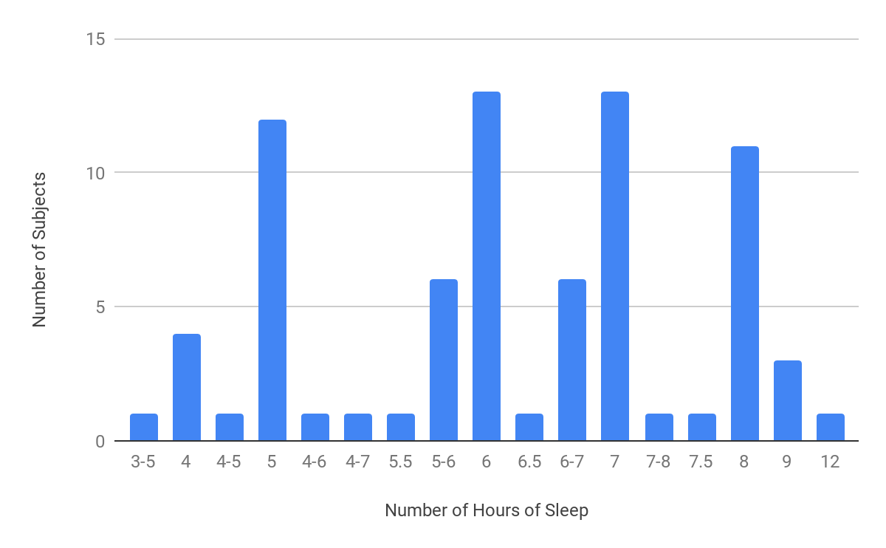
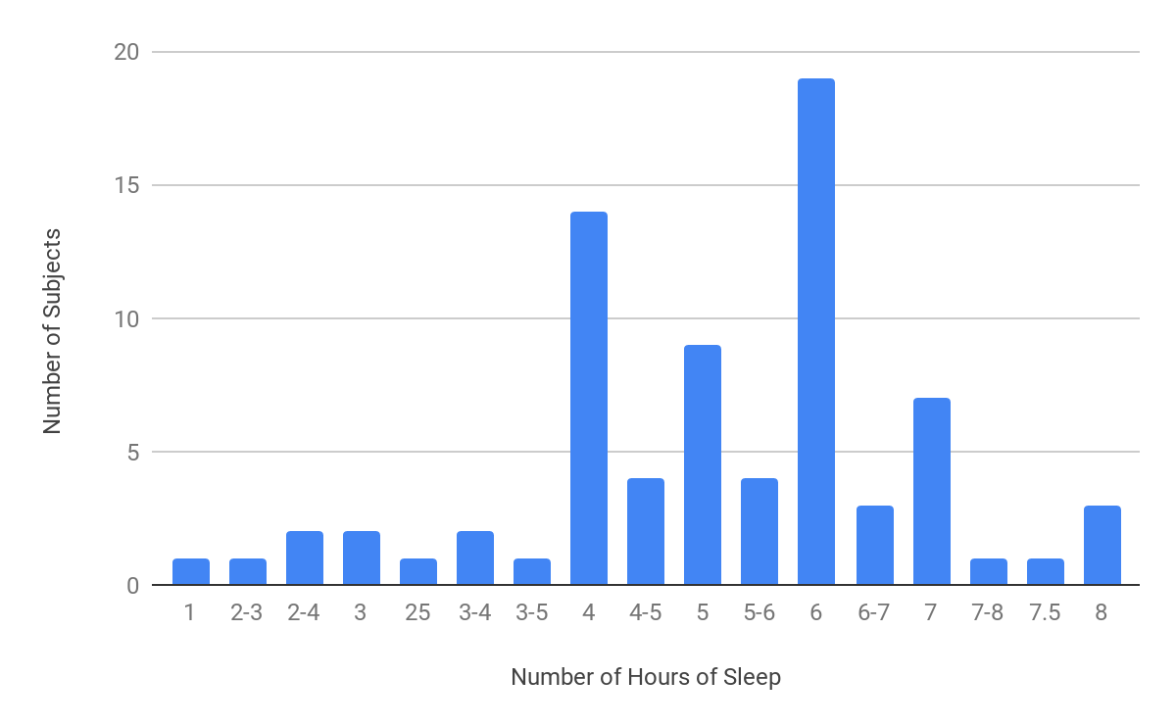
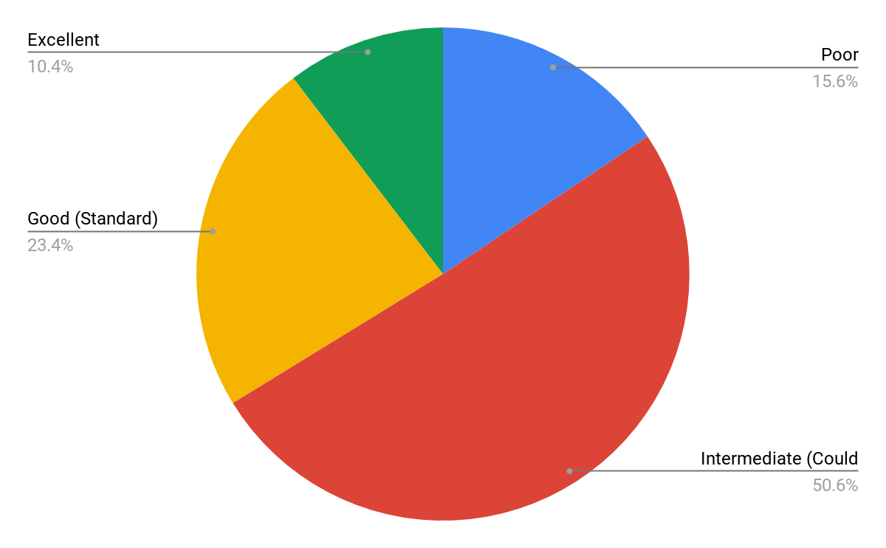
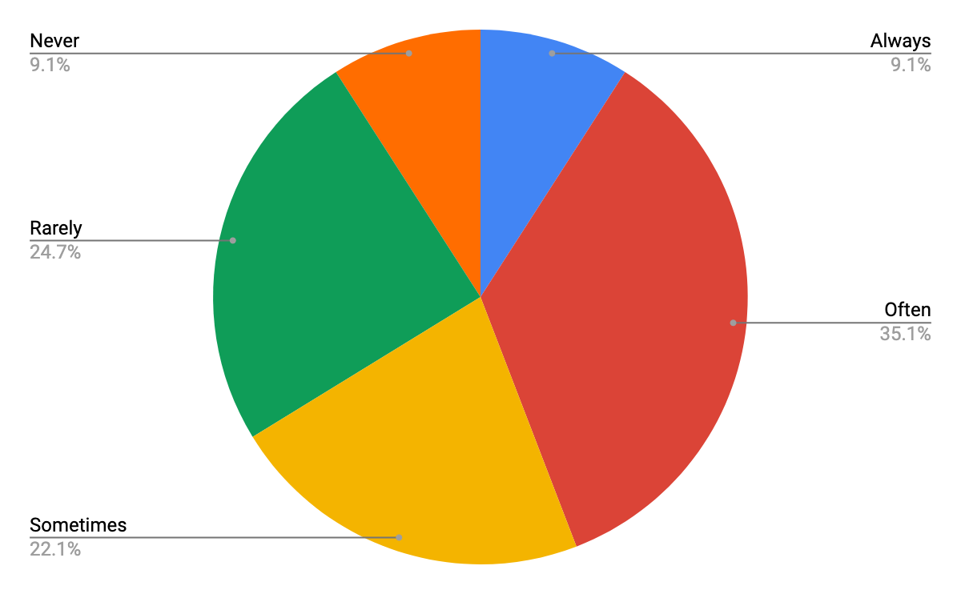
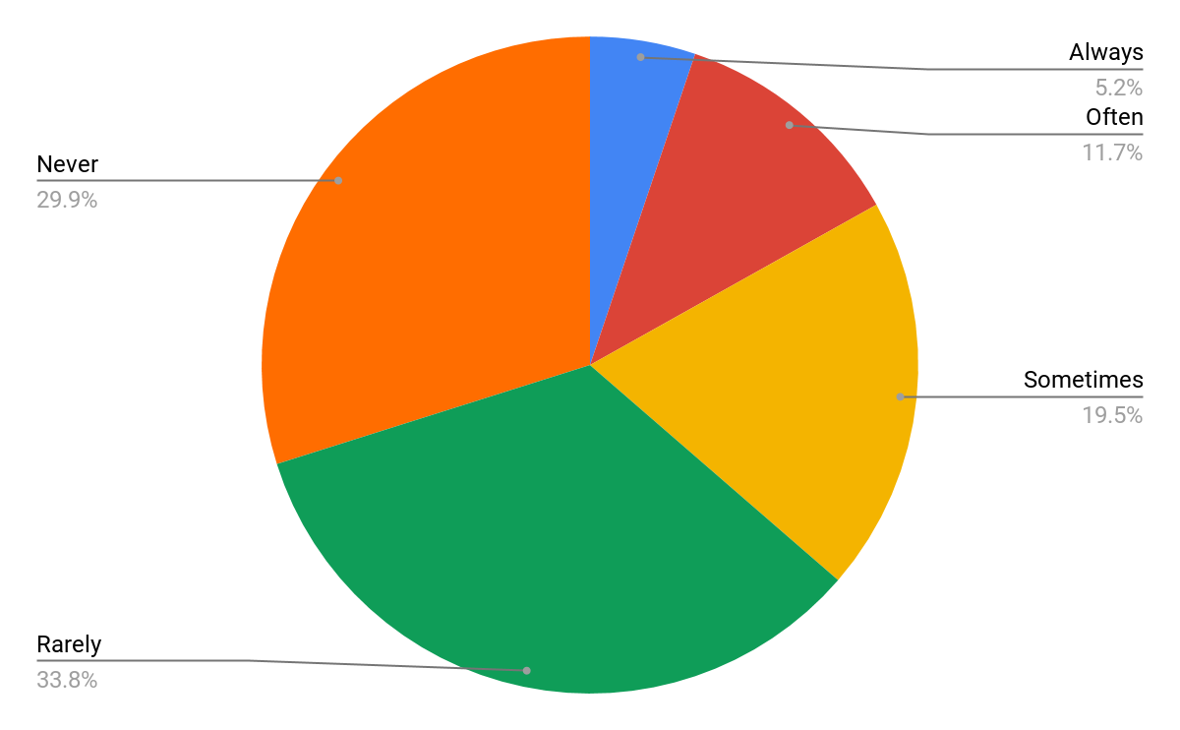
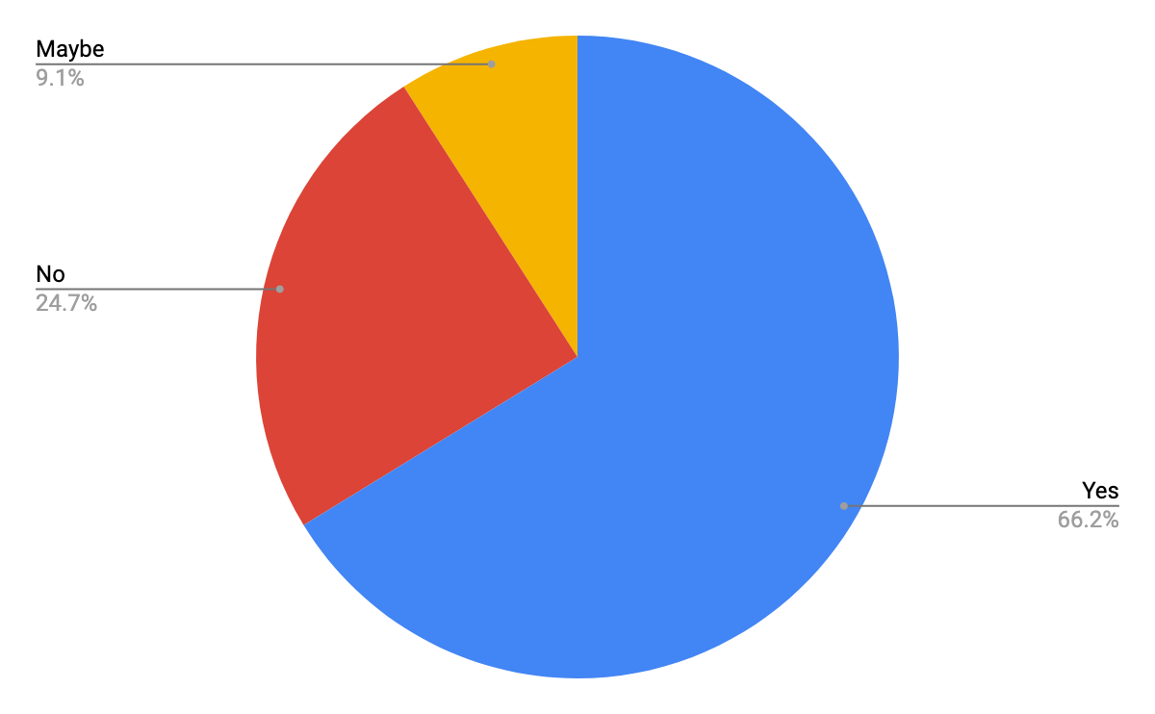
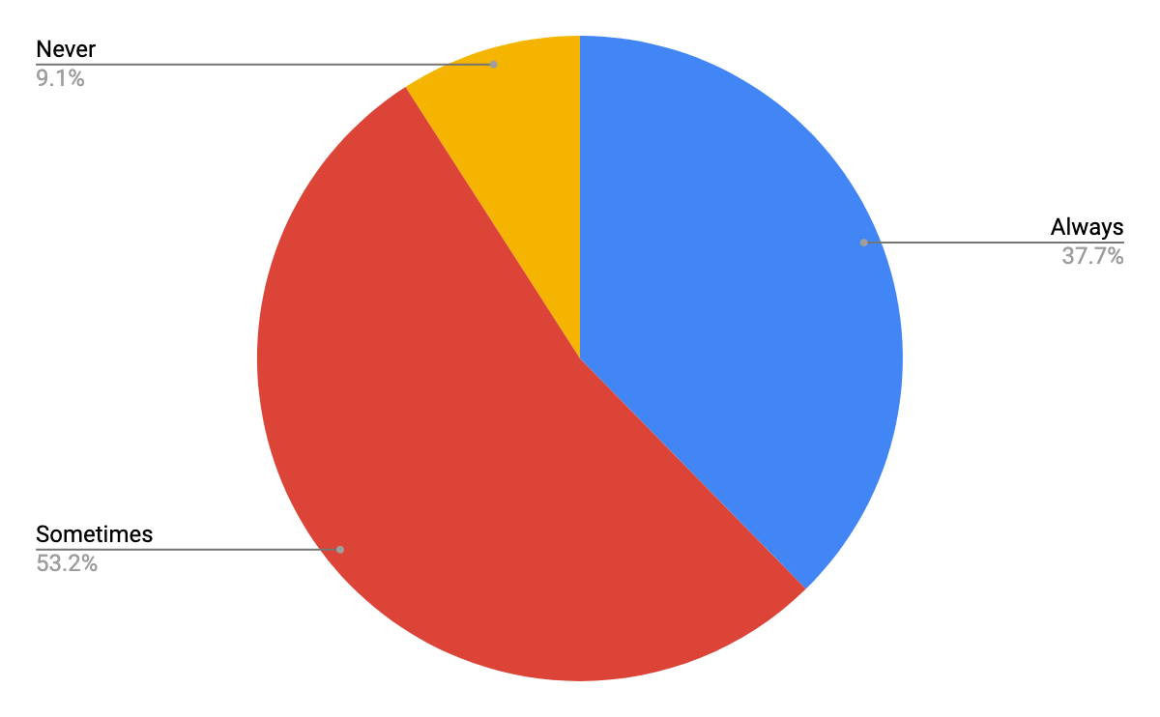
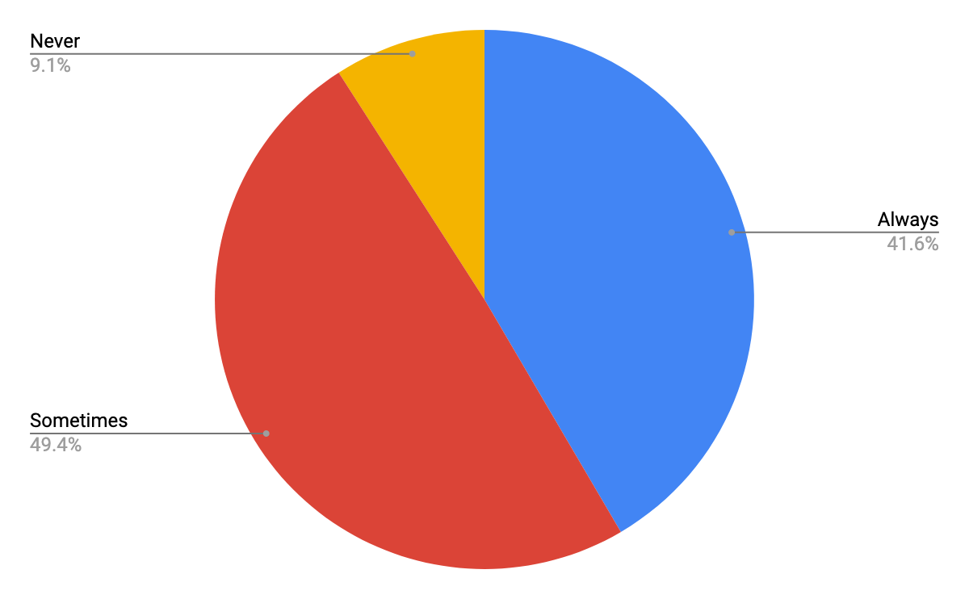
The Negative Impact of Poor Time Management on Sleep Deprivation in College Students
By: Diane DeLosSantos, Adan Khan, Ifeoluwa Tugbobo
INTRODUCTION
RESULTS
DISCUSSION
- Sleep deficiency can cause people to have trouble making decisions, solving problems, and controlling their emotions and behavior. It can also slow down people’s reaction time, cause them to be less productive at work and school, and make it difficult for them to stay awake throughout the day. Lastly, ongoing sleep deficiency is linked to an increased risk of diseases, such as kidney disease and obesity. (National Heart, Lung, and Blood Institute)
- Sleep deficiency and sleep deprivation can occur when people don’t leave enough time for sleep, which implies that time management can impact people’s sleep schedules (National Heart, Lung, and Blood Institute).
- A study in 2006 found that 42% of the college students experienced excessive daytime sleepiness and these students were more likely to procrastinate (Edens 2006).
- We decided to investigate whether or not poor time management leads to an increase in sleep deprivation in college students.
- We hypothesized that if a college student does not know how to properly manage their time, then he/she will experience more sleep deprivation than they normally would.
- We identified college students as sleep deprived if they received less than 7-9 hours of sleep each day (National Sleep Foundation 2015).
According to Figure 1, the highest number of hours of sleep participants normally received was 6-7. The second highest was 5 hours and the third highest was 8 hours.
- The results seem to support our hypothesis.
- 40 out of the 77 participants were sleep deprived. Of these 40 college students, 28 reported sleeping even less during a busy week of school.
- Of these 28 college students, 15 reported having intermediate time management skills, 16 reported never or rarely submitting assignments/preparing for tests late, 23 reported having submitted assignment(s) late or right before it was due, during the last semester, 15 reported always rushing to finish their work/study, and 18 reported always staying up late to finish their work.
- Lack of time management skills seems to cause college students to rush to finish their work/study and stay up late to finish their work, which, in turn, causes them to be sleep deprived and during a busy week, experience even more sleep deprivation.
- The limitations of this study were that our results can’t be used to generalize to other populations of college students, outside factors could affect the amount of sleep college students receive, and all the data collected was self-reported.
- Further research needs to be conducted to determine if there is a strong association between sleep deprivation and time management skills, as well as sleep deprivation and procrastination.
According to Figure 2, the highest number of hours of sleep participants received daily, during a busy week of school, was 6. The second highest was 4 hours and the third highest was 5 hours. The lowest number of hours of sleep was 1.
Figure 1: Number of Hours of Sleep Normally Get
According to Figure 3, 50.6% reported possessing intermediate time management skills. 23.4% reported possessing good time management skills. 15.6% reported possessing poor time management skills. 10.4% reported possessing excellent time management skills.
Figure 2: Average Number of Hours of Sleep Received, During Busy Week
According to Figure 4, 35.1% reported submitting assignments/preparing for tests early often. 22.1% reported submitting assignments/preparing for tests early sometimes. 24.7% reported submitting assignments/preparing for tests early rarely. 9.1% reported submitting assignments/preparing for tests early never. 9.1% reported submitting assignments/preparing for tests early always.
Figure 3: Type of Time Management Skills
Figure 4: Frequency of Early Submission of Assignments/Preparation for Tests
According to Figure 5, 33.8% reported submitting assignments/preparing for tests late rarely. 19.5% reported submitting their assignments/preparing for tests late sometimes. 29.9% reported submitting assignments/preparing for test late never. 11.7% reported submitting their assignments/preparing for tests late often. 5.2% reported submitting assignments/preparing for tests late always.
MATERIALS & METHODS
REFERENCES
- 77 college students completed an online survey, created using Google Forms.
1. Gender
2. Age
3. Number of Hours of Sleep Received Last Night
4. Number of Hours of Sleep Normally Receive
5. Average Number of Hours of Sleep Receive Daily, During Busy Week
6. Type of Time Management Skills
7. Early Submission of Assignments/Preparation for Tests
8. Late Submission of Assignments/Preparation for Tests
9. Submission of Assignment(s) Late or Right Before Due, Last Semester
10. Rushing to Finish Their Work or Study
11. Stay Up Late to Finish Their Work
Edens KM. 2006. The Relationship of University Students Sleep Habits and Academic Motivation. NASPA Journal [Internet]. [cited 27 March 2019]; 43:432–445. Available from: https://www.tandfonline.com/doi/abs/10.2202/1949-6605.1677
MindTools. What Is Time Management? Working Smarter to Enhance Productivity [Internet]. London (UK): MindTools; [cited 2019 Mar 27]. Available from: https://www.mindtools.com/pages/article/newHTE_00.htm
National Sleep Foundation. 2015. National Sleep Foundation Recommends New Sleep Times [Internet]. Washington (DC): National Sleep Foundation; [cited 2019 Mar 27]. Available from: https://www.sleepfoundation.org/press-release/national-sleep-foundation-recommends-new-sleep-times
National Heart, Lung, and Blood Institute. Sleep Deprivation and Deficiency [Internet]. Bethesda (MD): National Heart, Lung, and Blood Institute; [cited 2019 Mar 27]. Available from: https://www.nhlbi.nih.gov/health-topics/sleep-deprivation-and-deficiency
Somnique Sleep Health. Sleep Deprivation or Deficiency [Internet]. Portland (OR): Somnique Sleep Health; [cited 2019 Mar 27]. Available from: https://somnique.com/sleep-disorders/sleep-deprivation-or-deficiency/
University Health Center University of Georgia. Sleep Rocks! ...Get more of it! [Internet]. Athens (GA): University Health Center University of Georgia; [cited 2019 Mar 27]. Available from: https://www.uhs.uga.edu/sleep
According to Figure 6, 66.2% reported having submitted assignment(s) late or right before it was due, last semester. 24.7% reported not having submitted assignment(s) late or right before it was due, last semester. 9.1% reported possibly having submitted assignment(s) late or right before it was due, last semester.
Figure 5: Frequency of Late Submission of Assignments/Preparation for Tests
Figure 6: Submission of Assignments Late or Right Before It Was Due, During Last Semester
According to Figure 7, 53.2% reported rushing to study/finish their work sometimes. 37.7% reported rushing to study/finish their work always. 9.1% reported rushing to study/finish their work never.
According to Figure 8, 49.4% reported staying up late to finish their work sometimes. 41.6% reported staying up late to finish their work always. 9.1% reported staying up late to finish their work never.
Figure 7: Frequency of Rushing to Study/Finish Homework
Figure 8: Frequency of Staying Up Late to Finish Work

